Slide 1
Computer Organization & Design —The Hardware/Software Interface
Chapter 5:
Large and Fast: Exploiting Memory Hierarchy

Slide 2
Chapter Five: Large and Fast: Exploiting Memory Hierarchy
5.1 Introduction
5.2 Memory technology
5.3 The basics of Caches
5.4 Measuring and Improving Cache Performance
5.5 Dependable Memory Hierarchy
5.7 Virtual Memory
5.6 Virtual Machines
5.8 A Common Framework for Memory Hierarchies
5.9 Using a Finite-State Machine to Control a Simple Cache

Slide 3
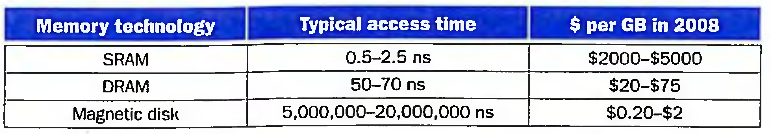
Memory technologies
Main memory is implemented from DRAM
dynamic random access memory
caches use SRAM
static random access memory
magnetic disk
Flash memory is used instead of disks in many embedded devices; see Section 6.4

Slide 4
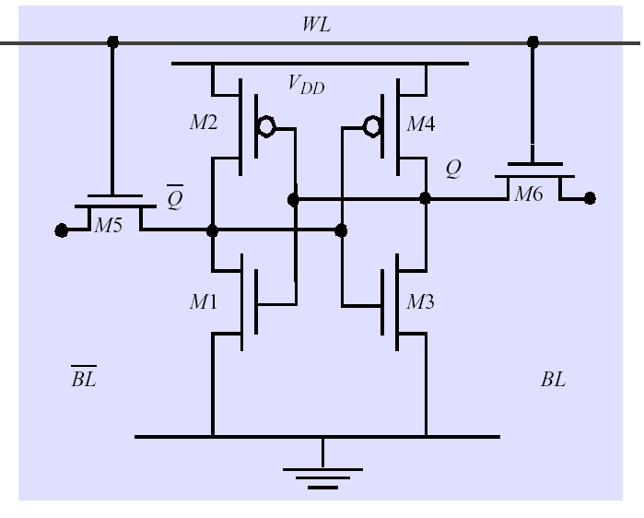
SRAM vs. DRAM
DRAM:
value is stored as a charge on capacitor (must be refreshed)
very small but slower than SRAM (factor of 5 to 10)
High density, low power, cheap, slow
Dynamic: needs to be “refreshed” regularly
SRAM:
value is stored on a pair of inverting gates
very fast but takes up more space than DRAM (4 to 6 transistors)
Low density, high power, expensive, fast
Static: content will last “forever”(until lose power)
Word Line
C
. . .
Bit Line
Sense Amp

Slide 5
What’s DDR
Classic DRAM
has an asynchronous interface, which means that it responds as quickly as possible to changes in control inputs.
SDRAM (Synchronous dynamic random access memory )
dynamic random access memory (DRAM) that is synchronized with the system bus.
slower than the DDR variants, because only one word of data is transmitted per clock cycle (single data rate), called SDR SDRAM.
DDR SDRAM (DDR1)
Has a double data rate interface. This uses the same commands, accepted once per cycle, but reads or writes two words of data per clock cycle.
DDR2 SDRAM
similar to DDR SDRAM, but doubles the minimum read or write unit again, to 4 consecutive words.

Slide 6
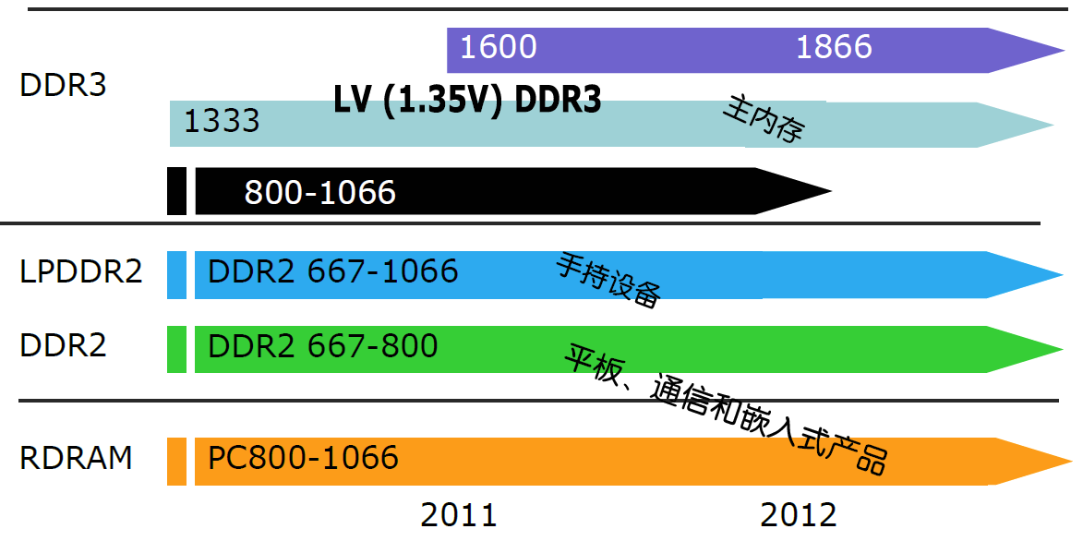
DDR3
DDR3
2133？
酷睿i以后的笔记本都采用DDR3（1600或1333）

Slide 7
Problem ?
Application requirements:
Unlimited amounts of memory
Faster memory, higher bandwidth
Lower price per byte
If for embedded systems: lower power comsumption
These requirements are contradictory.
The bigger, more difficult to make it fast
The faster, more expensive
The faster will consume much more power.

Slide 8
Ready
Ready

Slide 9
example
C | Function | Control signals
C5 | MAR←(R1) | Rlout，MARin
C6 | MDR←M(MAR) A←(R0) | MemR，MDRinE R0out，Ain
C7 | AC←(MDR)+(A) | MDRout，Add，ACin
C8 | MDR←(AC) | ACout，MDRin
C9 | M(MAR)←(MDR) | MDRouE，MemW
C | Function | Control signals
C1 | MAR←(PC) | PCout, MARin
C2 | MDR←M(MAR) PC←(PC)+1 | MemR, MDRinE PC+1
C3 | IR←(MDR) | MDRout, IRin
C4 | Decoding | none

Slide 10
principle of locality of reference !
Locality---- two important concepts
1. temporal locality (locality in time):
If an item is referenced, it will tend to be referenced again soon.
2. spatial locality (locality in space):
If an item is referenced, items whose addresses are close by will tend to be referenced soon.
As we know, these tow principles actually exists in most programs.
Why does code have locality?
Our initial focus: two levels (upper, lower)
Block or Line: minimum unit of data (block) for transfers
hit: data requested is in the upper level
miss: data requested is not in the upper level

Slide 11
Solution: Memory hierarchy
Build a memory hierarchy
S
p
e
e
d
C
P
U
S
i
z
e
C
o
s
t
(
$
/
b
i
t
)
processor
upper
F
a
s
t
e
s
t
M
e
m
o
r
y
S
m
a
l
l
e
s
t
H
i
g
h
e
s
t
Data are transferred
M
e
m
o
r
y
S
l
o
w
e
s
t
M
e
m
o
r
y
B
i
g
g
e
s
t
L
o
w
e
s
t

Slide 12
Some important items
Hit
The CPU accesses the upper level and succeeds.
Miss
The CPU accesses the upper level and fails.
Hit time:
The time to access the upper level of the memory hierarchy, which includes the time needed to determine whether the access is a hit or a miss.
miss penalty:
The time to replace a block in the upper level with the corresponding block from the lower level, plus the time to deliver this block to the processor.

Slide 13
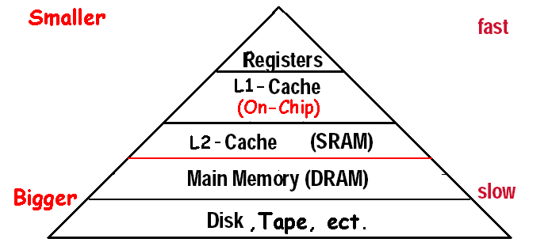
Exploiting Memory Hierarchy
Hierarchies bases on memories of different speeds and size
The more closely CPU the level is,the faster the one is.
The more closely CPU the level is,the smaller the one is.
The more closely CPU the level is,the more expensive
Increasing distance form the CPU in access time
Levels in the memory hierarchy
Size of the memory at each level

Slide 14
There has been exploited Memory Hierarchy
The basics of Cache: SRAM and DRAM (main memory)
The solution is in speed
Virtual Memory: DRAM and DISK
The solution is in size

Slide 15
5.2 The basics of Cache
Simple implementations
Two issues:
How do we know if a data item is in the cache?
If it is, how do we find it?
Our first example: "direct mapped"
block size is one word of data
For each item of data at the lower level, there is exactly one location in the cache where it might be.
e.g., lots of items at the lower level share locations in the upper level

Slide 16
Direct Mapped Cache
Where can a block be placed in the upper level?
index
8 Block
Direct-mapping algorithm.
memory address is modulo the number of blocks in the cache
Fortunately, while the cache has 2^{n} blocks, the corresponding index is equal to the lowest n bits of memory block address. Here n=3. Let’s check.

Slide 17
Accessing a cache--- how do we find it?
Memory block address is larger than cache block address
TAG
Index
Block offset
Block address MOD Numbers of Cache Block
Index | V | Tag | Data
000 | N
001 | N
010 | N
011 | N
100 | N
101 | N
110 | N
111 | N
a. The initial state of the cache after power-on
valid bit

Slide 18
Access sequence
10110,11010,10110,11010,10000,00011,10000,10010
Index | V | Tag | Data
000 | N
001 | N
010 | N
011 | N
100 | N
101 | N
110 | Y | (10)₂ | Memory(10110)
111 | N
b. After handling a miss of address(10110)
Index | V | Tag | Data
000 | N
001 | N
010 | Y | (11)₂ | Memory(11010)
011 | N
100 | N
101 | N
110 | Y | (10)₂ | Memory(10110)
111 | N
c. After handling a miss of address(11010)
Index | V | Tag | Data
000 | N
001 | N
010 | Y | (11)₂ | Memory(11010)
011 | N
100 | N
101 | N
110 | Y | (10)₂ | Memory(10110)
111 | N
d. After handling a hit of address(10110)
Index | V | Tag | Data
000 | N
001 | N
010 | Y | (11)₂ | Memory(11010)
011 | N
100 | N
101 | N
110 | Y | (10)₂ | Memory(10110)
111 | N
e. After handling a hit of address(11010)

Slide 19
Access sequence-2
10110,11010,10110,11010,10000,00011,10000,10010
Index | V | Tag | Data
000 | Y | (10)₂ | Memory(10000)
001 | N
010 | Y | (11)₂ | Memory(11010)
011 | N
100 | N
101 | N
110 | Y | (10)₂ | Memory(10110)
111 | N
f. After handling a miss of address(10000)
Index | V | Tag | Data
000 | Y | (10)₂ | Memory(10000)
001 | N
010 | Y | (11)₂ | Memory(11010)
011 | Y | (00)₂ | Memory(00011)
100 | N
101 | N
110 | Y | (10)₂ | Memory(10110)
111 | N
g. After handling a miss of address(00011)
Index | V | Tag | Data
000 | Y | (10)₂ | Memory(10000)
001 | N
010 | Y | (11)₂ | Memory(11010)
011 | Y | (00)₂ | Memory(00011)
100 | N
101 | N
110 | Y | (10)₂ | Memory(10110)
111 | N
h. After handling a hit of address(10000)
Index | V | Tag | Data
000 | Y | (10)₂ | Memory(10000)
001 | N
010 | Y | (11)→ (10)₂ | Memory(10010)
011 | Y | (00)₂ | Memory(00011)
100 | N
101 | N
110 | Y | (10)₂ | Memory(10110)
111 | N
i. After handling a miss of address(10010)

Slide 20
Direct Mapped Cache construction
temporal

Slide 21
Bits in Cache
Example
How many total bits are required for a direct-mapped cache 16KB of data and 4-word blocks, assuming a 32-bit address?
Answer
16KB=4KWord= 2¹² word = 2¹⁴ Bytes
One block=4 words = 2² words = 2⁴ bytes
Number of blocks (index bit) = 2¹² ÷ 2² = 2¹⁰ blocks
Data bits of block =4×32=128 bits
Tag bits = address – index-block size =32-10–4 =18 bits
Valid bit = 1 bit
Total Cache size = 2¹⁰ × (128+18+1)= 2¹⁰×147= 147 Kbits = 18.4KB
It is about 1.15 times as many as needed just for the data

Slide 22
Mapping an Address to Multiword Cache Block
Example
Consider a cache with 64 blocks and a block size of 16 bytes.
What block number does byte address 1200 map to?
Answer
(Block address) modulo (Number of cache blocks)
Where the address of the block is
75 modulo 64 =11
Byte address
1200
=
= 75
Bytes per block
16
Notice!!!
Byte address
×Byte per block
Byte address
+( Byte per block-1)
Bytes per block
Bytes per block
×Byte per block
Here:
1200 1215

Slide 23
Real address mapping
1200→ 1024+ 128 + 32 + 16 + 2
1 001011 0010
index block offset
Block size: 16 bytes = 2⁴ (4 bits block offset)
So block number = 75
64 blocks: 64 = 2⁶ 6 bits index （64 block）

Slide 24
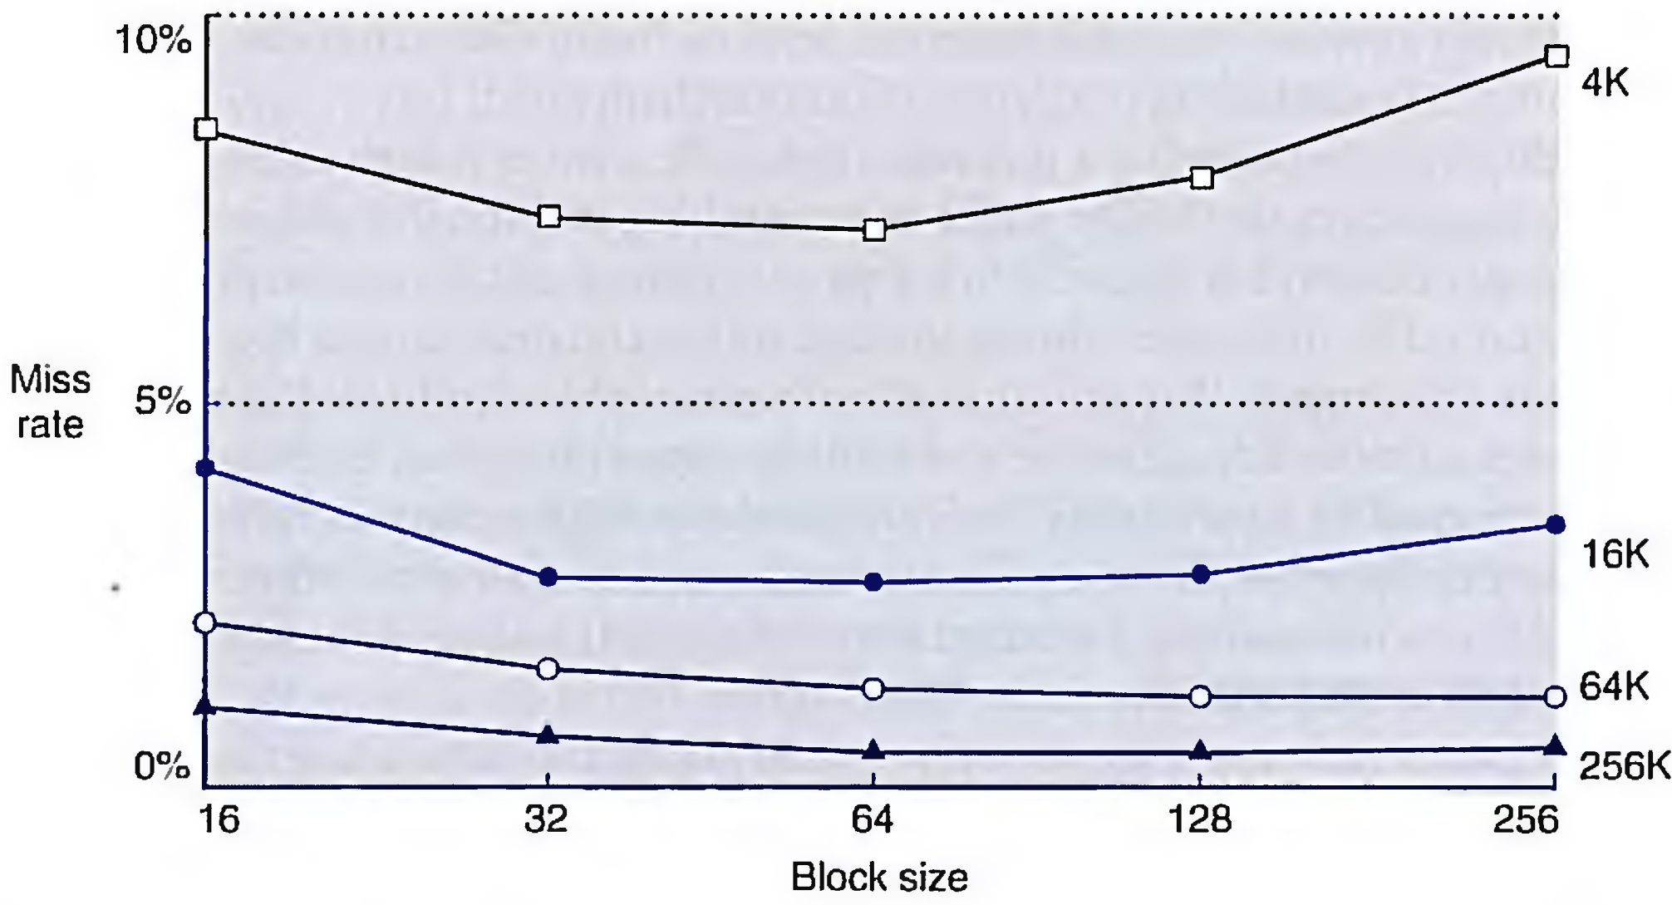
Miss rate versus block size.

Slide 25
Handling Cache reads hit and Misses
Read hits
this is what we want!
Read misses—two kinds of misses
instruction cache miss
data cache miss
let’s see main steps taken on an instruction cache miss
stall the CPU, fetch block from memory, deliver to cache, restart CPU read
1. Send the original PC value (current PC-4) to the memory.
2. Instruct main memory to perform a read and wait for the memory to complete its access.
3. Write the cache entry, putting the data from memory in the data portion of the entry, writing the upper bits of the address (from the ALU) into the tag field,and turning the valid bit on.
4. Restart the instruction execution at the first step, which will refetch the instruction again, this time finding it in the cache.

Slide 26
Direct Mapped Cache construction
0x40000020
temporal

Slide 27
Handling Cache Writes hit and Misses
Write hits: Difference Strategy
write-back: Cause Inconsistent
Wrote the data into only the data cache
Strategy ---- write back data from the cache to memory later
Fast
write-through: Ensuring Consistent
Write the data into both the memory the cache
Strategy ---- writes always update both the cache and the memory
Slower----write buffer
Write misses:
read the entire block into the cache, then write the word----write allocate
Write around the data into the memory ( the lower level memory) ----no write allocate ( also called write around ).

Slide 28
Example
Assume a direct mapped wtrie-back cache with many cache entries that starts empty.below is a sequence of five memory operations(the address is in square brackets):
1 write Mem[100];
2 write Mem[100]; 100, 200 mapped to
3 Read Mem[200]; the same line in cache
4 write Mem[200];
write Mem[100];
Answer :
for no-write allocate misses: 1,2,3,5
hit : 4
for write allocate misses: 1,3, 5
hit : 2,4,

Slide 29
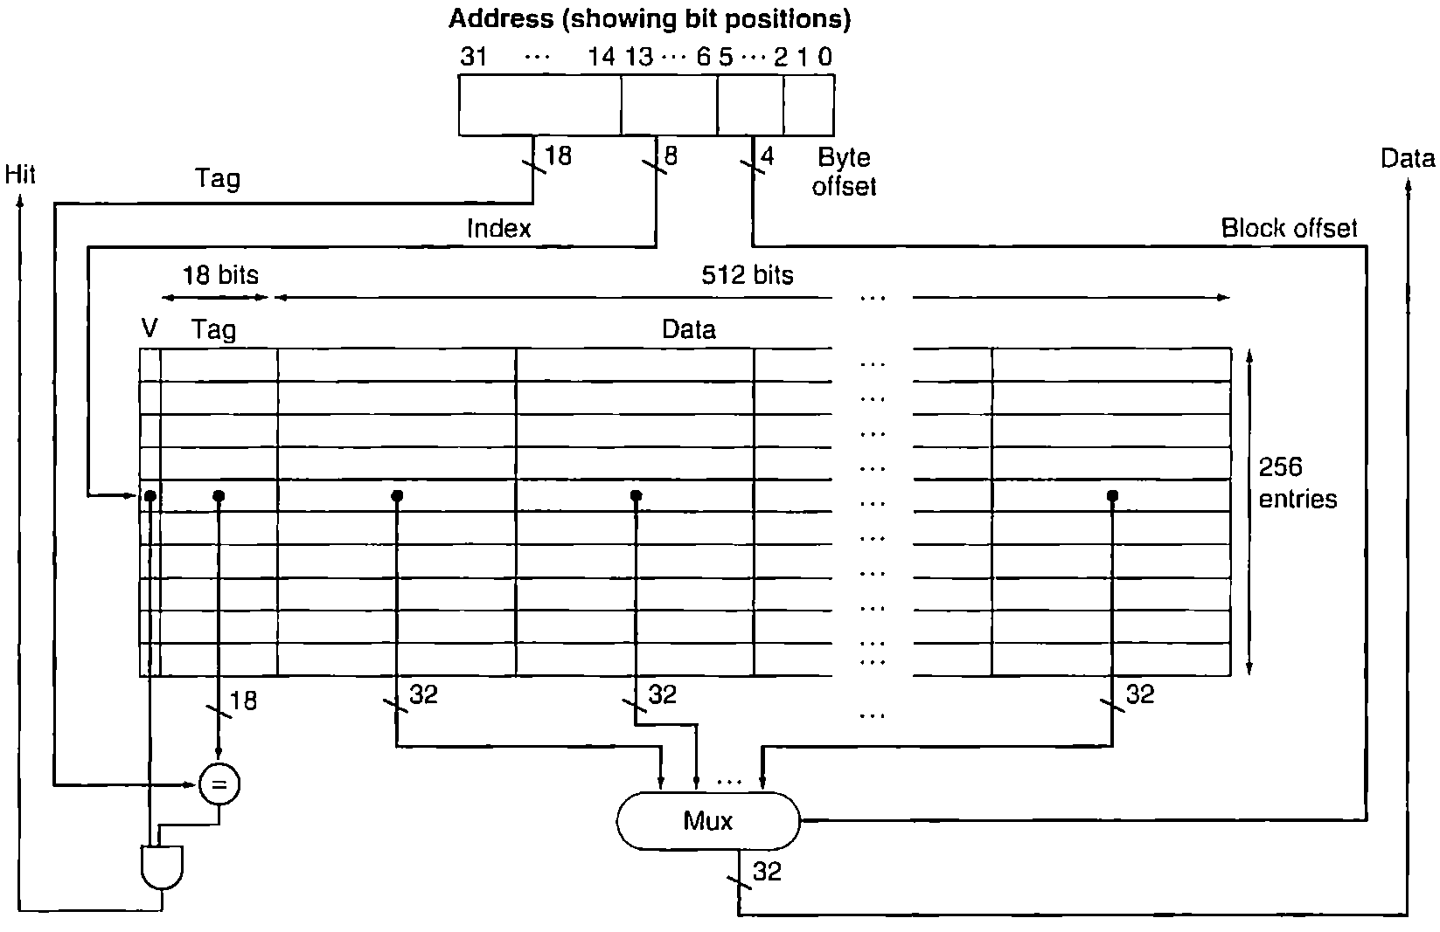
An example cache: the intrinsity FastMATH Processor
The 16 KB caches in the Intrinsity FastMATH each contain 256 blocks with 16 words per block.

Slide 30
read request
1. Send the address to the appropriate cache. The address comes either from the PC (for an instruction) or from the ALU (for data).
2. If the cache signals hit, the requested word is available on the data lines. Since there are 16 words in the desired block, we need to select the right one. A block offset field is used to control the multiplexor (shown at the bottom of the figure), which selects the requested word from the 16 words in the indexed block.
3. If the cache signals miss, we send the address to the main memory. When the memory returns with the data, we write it into the cache and then read it to fulfill the request.

Slide 31
writes
both write-through and write-back, leaving it up to the operating system to decide which strategy to use for an application.
It has a one-entry write buffer.

Slide 32
Approximate instruction and data miss rates for the Intrinsity FastMATH processor for SPEC2000 benchmarks.
combined cache vs split caches

Slide 33
Designing the Memory system to Support Cache
Make reading multiple words easier by using banks of memory
It can get a lot more complicated...

Slide 34
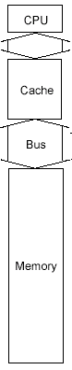
Performance basic memory organization
Assume
1 clock cycles to send the address
15 memory bus clock cycles for each DRAM access initiated
1 bus clock cycles to send a word of data
Block size is 4 words
Every word is 4 bytes
The time to transfer one word is 1+15+1=17
The miss penalty (The time to transfer one block is):
1+4×(15+1)＝65 CLKs
Bandwidth :
Memory
4×4
1
≈
65
4

Slide 35
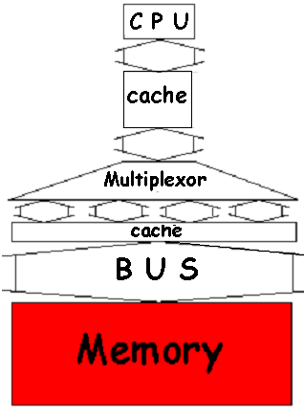
Performance in Wider Main Memory
With a main memory width of 2 words(64bits)
The miss penalty: 4words/Block
1+2×(15+1)＝33 CLKs
Bandwidth :
With a main memory width of 4 words(128bits)
The miss penalty: 4words/Block
1+1×(15+1)＝17 CLKs
Bandwidth :
4×4
16
only two times that needed to transfer one word.
＝
≈0.48
33
33
4×4
16
＝
≈0.98
17
17
Equal to time to transfer one word.

Slide 36
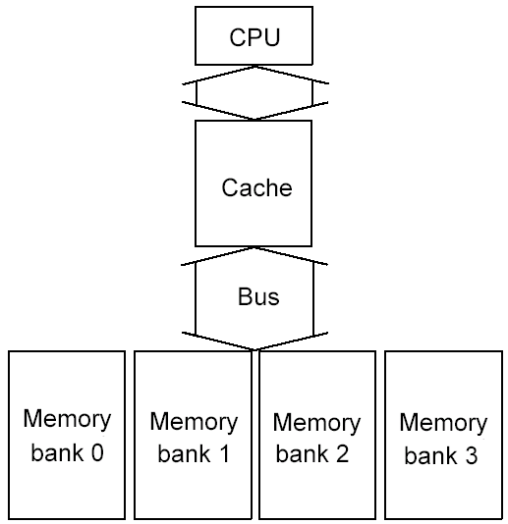
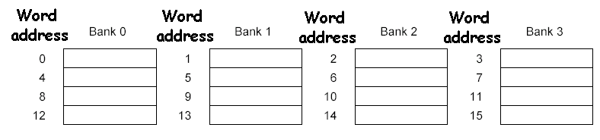
Performance in Four-way interleaved memory
With 4 banks Interleaved Memory
The miss penalty: 4words/Block
1+15 +(4 × 1)＝20
Bandwidth :
Four-way interleaved memory
4×4
Almost equal to time to transfer one word.
＝
0.8
20
Parallel access
Optimizes sequential address access patterns

Slide 37
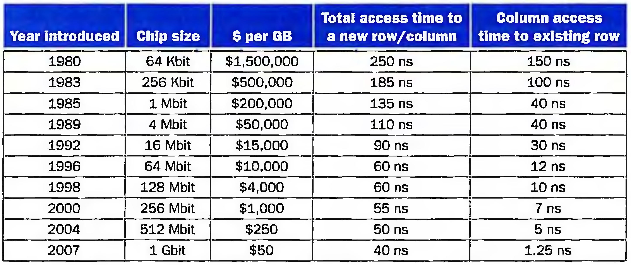
DRAM developed
DRAM size increased by multiples of four approximately once every three year until 1996,and thereafter doubling approximately every two years.

Slide 38
5.4 Measuring and improving cache performance
In this section, we will discuss two questions:
1. How to measure cache performance?
2. How to improve performance?
The main contents are the following:
1. Measuring cache performance
2. Reducing cache misses by more flexible placement of blocks
3. Reducing the miss penalty using multilevel caches
Average Memory Assess time = hit time + miss time
= hit rate × Cache time + miss rate ×memory time = 99% × 5 + (1-99%) ×（5 + 40）
= hit time + Miss Rate * Miss Panelty = 5 + （1-99%）* 40
Miss time = hit time + Miss Panelty

Slide 39
Measuring cache performance
We use CPU time to measure cache performance.
CPU time= (CPU execution clock cycles + Memory-stall clock cycles) ×Clock cycle time
Memory-stall clock cycles = # of instructions × miss ratio × miss penalty
= Read-stall cycles + Write-stall cycles
For Read-stall
Read-stall cycles = ×Read miss rate ×Read miss penalty
For a write-through plus write buffer scheme:
Write-stall cycles= × Write miss rate ×Write miss penalty
+ Write buffer stalls
If the write buffer stalls are small, we can safely ignore them .
Read
Program
write
Program

Slide 40
Combine the reads and writes
In most write-through cache organizations, the read and write miss penalties are the same
the time to fetch the block from memory.
If we neglect the write buffer stalls, we get the following equation:
Memory-stall clock cycles ＝
× Miss rate × Miss penalty
We can also write this as:
Memory-stall clock cycles ＝
Memory accesses
Program
Instructions
Misses
×
×Miss penalty
Program
Instructions

Slide 41
Calculating cache performance
Assume:
instruction cache miss rate 2%
data cache miss rate 4%
CPI without any memory stalls 2
miss penalty 100 cycles
The frequency of all loads and stores in gcc is 36% ( in Figure 3.26 )
Question: How faster a processor would run with a perfect cache?
Answer:
Instruction miss cycles = I×2%×100 =2.00 I
Data miss cycles = I×36%×4%×100 =1.44 I
Total memory-stall cycles= 2.00I+ 1.44I =3.44 I
CPI with stall = CPI with perfect cache + total memory-stalls
= (2 + 3.44 )I = 5.44 I
Speedup =
CPU time with stalls
I×CPI_{stall}×Clock cycle
5.44
=
=
=2.72
CPU time with perfect cache
I×CPI_{perfect}×Clock cycle
2

Slide 42
What happens if the processor is made faster?
Assume CPI reduces from 2 to 1
CPI with stall = CPI with perfect cache + total memory-stalls
=(1+3.44) I = 4.44I
CPU time with stalls
=
CPI_{stall}
=
4.44
=4.44
CPU time with perfect cache
CPI_{perfect}
1
Ratio time for Memory stalls
from
3.44
3.44
=63% to
=77%
5.44
4.44

Slide 43
Calculating cache performance with Increased Clock Rate
Suppose we increase the performance of the computer in the previous example by doubling its clock rate for same memory system.
Question : How much faster will the computer be with the faster clock to slow clock?
Answer
Total miss cycles per instruction = (2%×200) + 36%×(4%×200)=6.88
CPI with cache misses = 2 + 6.88 =8.88
Performance with fast clock
=
Execution time with slow clock
Performance with slow clock
Execution time with fast clock
=
IC×CPI_{slow clock}×Clock cycle
=
5.44
=1.23
IC×CPI_{fast clock}×Clock cycle/2
8.88×1/2
This, the computer with the faster clock is about 1.2 times faster rather than 2 time faster.

Slide 44
Calculating Average Memory Access Time
AMAT= Time for a hit + Miss rate x Miss penalty
Find the AMAT for a processor with a 1 ns clock cycle time, a miss penalty of 20 clock cycles, a miss rate of 0.05 misses per instruction, and a cache access time (including hit detection) of 1 clock cycle. Assume that the read and write miss penalties are the same and ignore other write stalls.
AMAT= 1 +0.05 x 20 = 2 clock cycles

Slide 45
Reducing cache misses by more flexible placement of blocks
(1) The disadvantage of a direct-mapped cache
(2) The basics of a set-associative cache
(3) Miss rate versus set-associative
(4) Locating a block in the set-associative cache
(5) Size of tags versus set associative
(6) Choosing which block to replace

Slide 46
The disadvantage of a direct-mapped cache
C
a
c
h
e
0
1
0
1
0
1
0
1
0
0
1
1
0
0
1
1
0
0
0
0
1
1
1
1
0
0
0
0
1
0
0
1
0
1
0
1
0
0
1
0
1
1
0
1
1
0
0
0
1
1
0
1
0
1
1
1
0
0
1
1
1
1
0
1
M
e
m
o
r
y
If the CPU requires the following memory units sequentially: word 0, word 8 and word 0. Word 0 and word 8 both are mapped to cache block 0, so the third access will be a miss.
But obviously, if one memory block can be placed in any cache block , the miss can be avoided. So, there is possibility that the miss rate can be improved.

Slide 47
Fully associative
C
a
c
h
e
0
1
0
1
0
1
0
1
0
0
1
1
0
0
1
1
0
0
0
0
1
1
1
1
0
0
0
0
1
0
0
1
0
1
0
1
0
0
1
0
1
1
0
1
1
0
0
0
1
1
0
1
0
1
1
1
0
0
1
1
1
1
0
1
M
e
m
o
r
y
Pros:
Avoid miss from address collision(same index in direct-mapped.)
Cons:
Complex and cost higher with much more comparers,
Longer hit time than direct-mapped.

Slide 48
Fully associative structure
Tag block offset
=
tag | V | data block
=
=
=
=
=
…… ……
=
=

Slide 49
The basics of a set-associative cache，Decreasing miss ratio with associativity
A set-associative cache is divided into some sets. A set contains several blocks.
A memory block is mapped to a set in the cache through a mapping algorithm.
The memory block can be placed in any block in the corresponding set.
The mapping algorithm is: (set with direct-mapped)
Set number (Index) =
(Memory block number) modulo (Number of sets in the cache)
If a set has only one block, this set-associative cache is actually a direct-mapped cache.
If a set-associative cache has only one set, this set-associative cache is called a fully-associative cache.

Slide 50
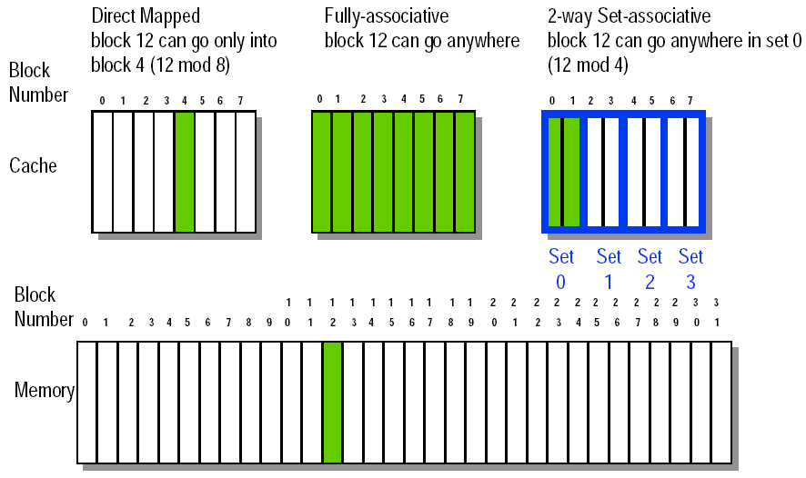
Memory block whose address is 12 in a cache with 8 blocks for different mapping

Slide 51
An eight-block cache configured as variety-way

Slide 52
Miss rate versus set-associativity—8Blocks
Assume: there are three small caches, each consisting of four one-word blocks.
One cache is direct-mapped,
the second is two-way set associative
and the third is fully associative.
Question: Given the following sequence of block addresses: 0,8,0,6,8, find the number of misses for each cache organization.
Answer: for direct-mapped 5 misses
Memory block | Hit or miss | Contents after each reference
 |  | Set 0 | Set 1 | Set 2 | Set 3
 |  | Block 0 | Block 1 | Block 2 | Block 3
0 | Miss | M[0]
8 | Miss | M[8]
0 | Miss | M[0]
6 | Miss | M[0] |  | M[6]
8 | Miss | M[8] |  | M[6]

Slide 53
Second, for the two-way set associative cache. 4 misses
Memory block | Hit or miss | Contents after each reference
 |  | Set 0 |  | Set 1
 |  | Block 0 | Block 1 | Block 2 | Block 3
0 | Miss | M[0]
8 | Miss | M[0] | M[8]
0 | Hit | M[0] | M[8]
6 | Miss | M[0] | M[6]
8 | Miss | M[8] | M[6]
Finally, for the fully associative cache. 3 misses
Memory block | Hit or miss | Contents after each reference
 |  | Only one set
 |  | Block 0 | Block 1 | Block 2 | Block 3
0 | Miss | M[0]
8 | Miss | M[0] | M[8]
0 | Hit | M[0] | M[8]
6 | Miss | M[0] | M[8] | M[6]
8 | Hit | M[0] | M[8] | M[6]

Slide 54
How much of a reduction in the miss rate is achieved by associativity?
Associativity | Data miss rate
1 | 10.3%
2 | 8.6%
4 | 8.3%
8 | 8.1%
The data cache miss rates for organization like the Intrinsuty FastMATH processor for SPEC2000 benchmarks with associativity varying form one-way to eight-way .
Data cache organization is 64KB data cache and 16-word block

Slide 55
Locating a block in the set-associative cache
The implementation of a four-way set-associative cache requires four comparators and a 4-to-1 multiplexor.

Slide 56
Size of tags versus set associativity
Assume
Cache size is 4K Block
Block size is 4 words
Physical address is 32bits
Question
Find the total number of set and total number of tag bits for variety associativity
Answer
Offset size (Byte) = 16= 2⁴ 4 bits for block offset
Number of memory block = 2³²÷2⁴=2²⁸ 28 bits for Block address
Number of cache block = 2¹² 12 bits for Block address
For direct-mapped
Bits of index = 12 bits
bits of Tag = (28-12) ×4K=16×4K=64 Kbits

Slide 57
For two-way associative
Number of cache set = 2¹² ÷ 2= 2¹¹
Bits of index = 12-1=11 bits
Bits of Tag = (28-11) ×2×2K = 17×2×2K=68 Kbits
For four-way associative
Number of cache set = 2¹² ÷ 4= 2¹⁰
Bits of index = 12-2=10 bits
Bits of Tag = (28-10) ×4×1K = 18×4×1K=72 Kbits
For full associative
Number of cache set = 2¹² ÷ 2¹² = 2⁰
Bits of index = 12-12=0 bits
Bits of Tag = (28-0) ×4K×1=128 Kbits
 | Direct | 2-way | 4-way | Fully
Index(bit) | 12 | 11 | 10 | 0
Tag(bit) | 16 | 17 | 18 | 28

Slide 58
Choosing which block to replace
In an associative cache, we must decide which block to replace when a miss happens and the corresponding set is full.
Random, FIFO, LRU
The most commonly used scheme is least recently used (LRU), which we used in the previous example. In an LRU scheme, the block replaced is the one that has been unused for the longest time.
For a two-way set associative cache, the LRU can be implemented easily. We could keep a single bit in each set. We set the bit whenever a specific block in the set is referenced, and reset the bit whenever another block is referenced.
As associativity increases, implementing LRU gets harder.

Slide 59
Decreasing miss penalty with multilevel caches
Add a second level cache:
often primary cache is on the same chip as the processor
use SRAMs to add another cache above primary memory (DRAM)
miss penalty goes down if data is in 2nd level cache
Example:
CPI of 1.0 on a 5GHz machine with a 2% miss rate, 100ns DRAM access
Adding 2nd level cache with 5ns access time decreases miss rate to 0.5%
Miss penalty to main memory is
The CPI with one level of caching
Total CPI = 1.0 + Memory-stall cycles per instruction
= 1.0 + 1.3 × 2% × 500 = 14.0
Miss penalty with levels of cache without access main memory
100ns
= 500 clock cycles
0.2
5ns
= 25 clock cycles
0.2

Slide 60
Example (Cont.)
The CPI with Two level of cache with 0.5% miss rate for main memory
Total CPI = 1.0 + Primary stalls per instruction + Secondary stalls per instruction
= 1 + 1.3 ×(2% ×25 + 0.5% × 500)
= 1.0 + 1.3 ( 0. 5 +2.5 ) = 4.9
The processor with secondary cache is faster by
Using multilevel caches:
try and optimize the hit time on the 1st level cache
try and optimize the miss rate on the 2nd level cache
14.0
= 2.86
4.9

Slide 61
Reducing the Miss Penalty Using Multilevel Caches
most microprocessors support an additional level of caching.
This second-level cache is usually on the same chip and is accessed whenever a miss occurs in the primary cache.
If the second-level cache contains the desired data, the miss penalty for the first-level cache will be essentially the access time of the second-level cache, which will be much less than the access time of main memory.
If neither the primary nor the secondary cache contains the data, a main memory access is required, and a larger miss penalty is incurred.
Total CPI = Base CPI + Memory-stall cycles per instruction
=1 + Primary stalls per instruction + Secondary stalls per instruction

Slide 62
Cache ABC
Mapping:
direct-map, set-associative, full-associative
Identification
Tag, index, block offset
Replacement
Write Policy

Slide 63
5.5 Dependable Memory Hierarchy
skip

Slide 64
5.7 Virtual Memory
Main memory can act as a cache for the secondary storage (disk)
Advantages:
illusion of having more physical memory
program relocation
protection
Virtual addr.
Physical addr.

Slide 65
Pages: virtual memory blocks
Page faults: the data is not in memory, retrieve it from disk
huge miss penalty, thus pages should be fairly large (e.g., 4KB)
reducing page faults is important (LRU is worth the price)
can handle the faults in software instead of hardware
using write-through is too expensive so we use write back

Slide 66
Page Tables
Virtual page

Slide 67
Placing a page and finding it again ----Page Tables
Virtual memory systems use fully associative mapping method

Slide 68
Page faults
When the OS creates a process, it usually creates the space on disk for all the pages of a process.
When a page fault occurs, the OS will be given control through exception mechanism.
The OS will find the page in the disk by the page table.
Next, the OS will bring the requested page into main memory. If all the pages in main memory are in use, the OS will use LRU strategy to choose a page to replace.
Virtual page

Slide 69
What about writes?
Because disk accesses are too slow, virtual memory systems can not use write-through strategy.
Instead, they must use write-back strategy. To do so, the machines need add a dirty bit to the entry of page table.
The dirty bit is set when a page is first written. If the dirty bit of a page is set, the page must be written back to disk before being replaced.

Slide 70
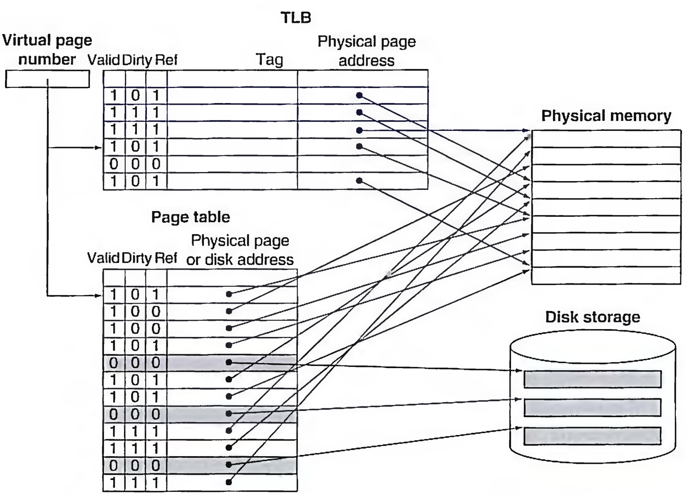
Making Address Translation Fast----TLB
A cache for address translations: translation look aside buffer

Slide 71
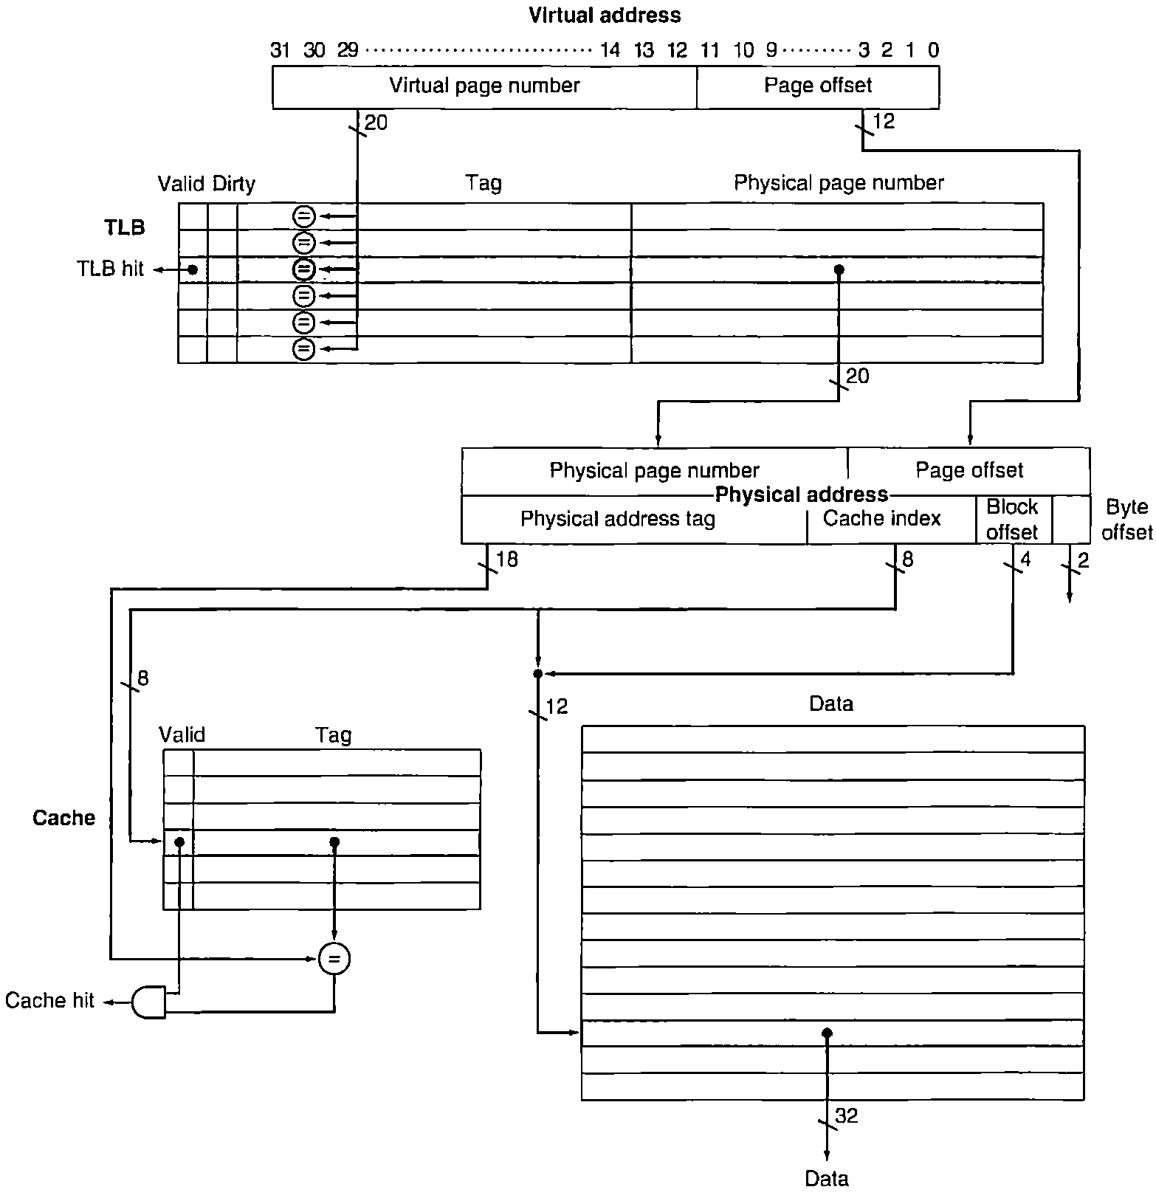
The TLB and cache implement the process of going from a virtual address to a data item in the Intrinsity FastMATH.

Slide 72
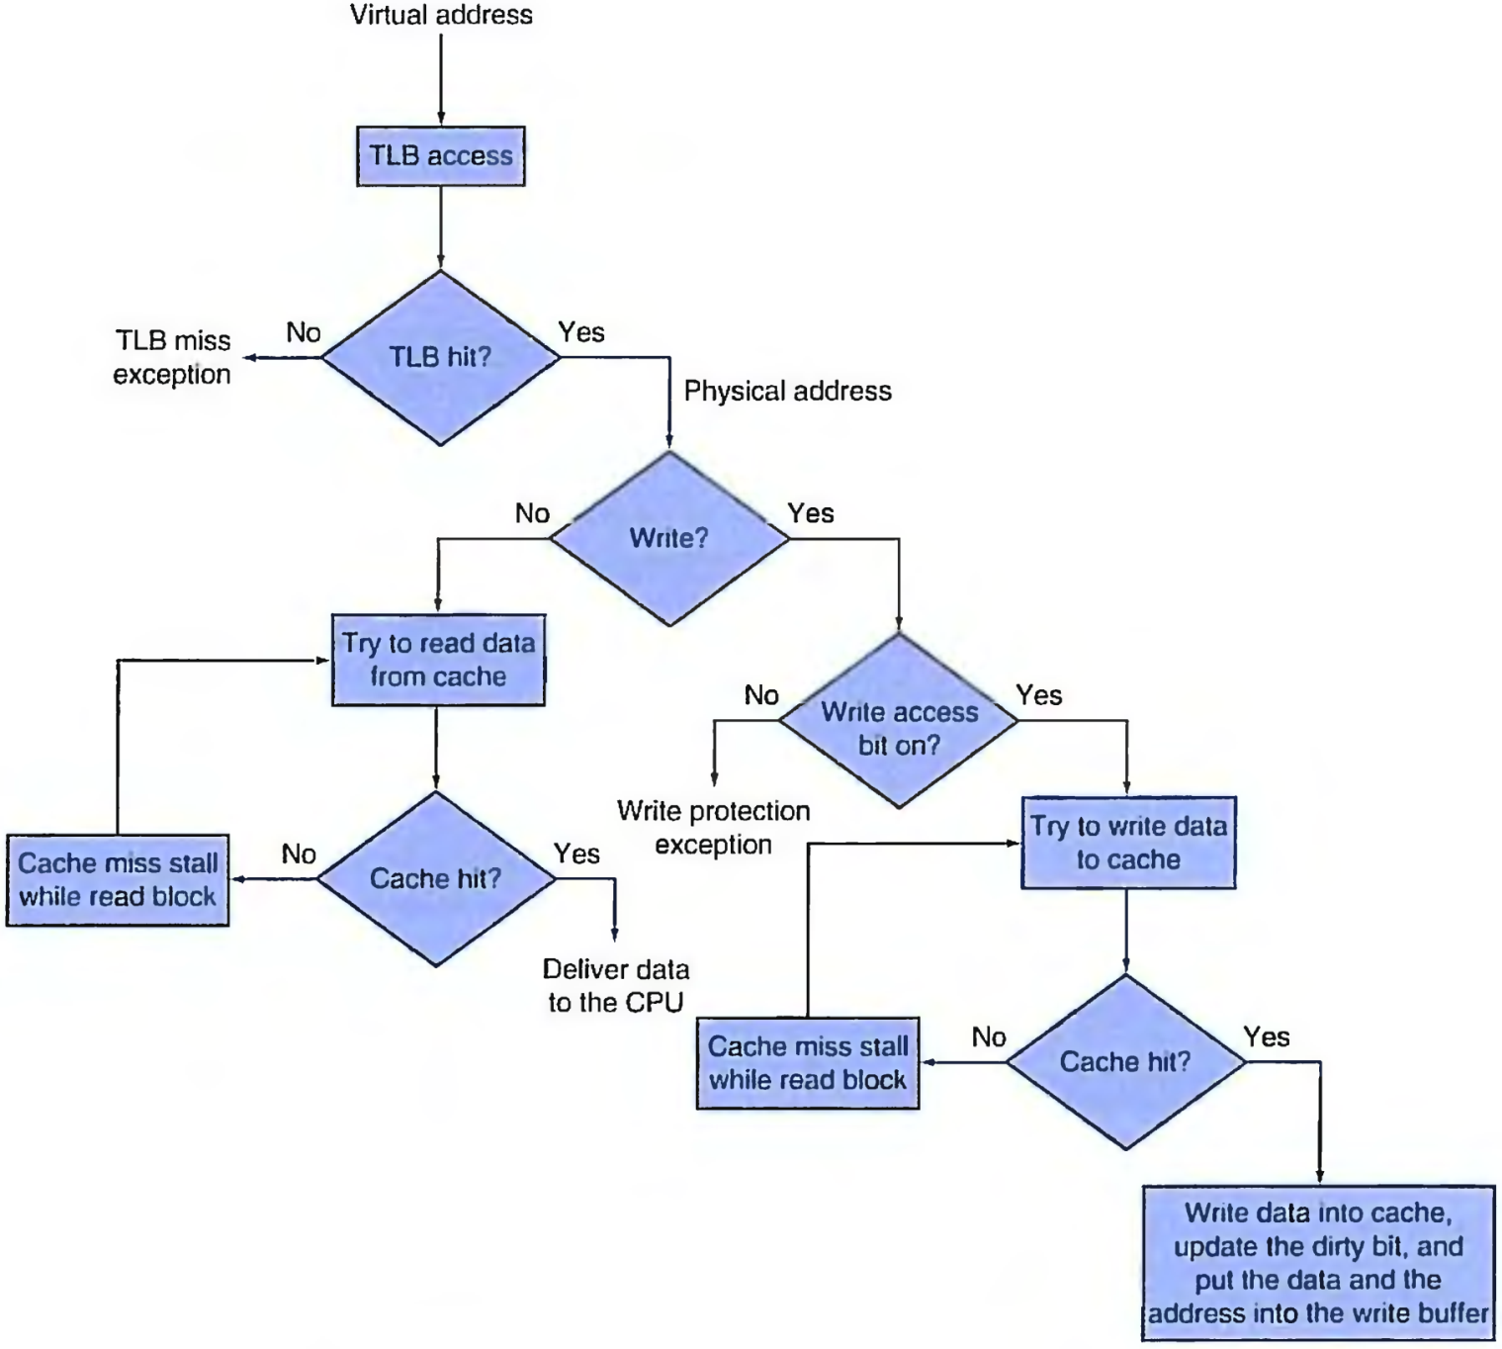
TLBs and caches

Slide 73
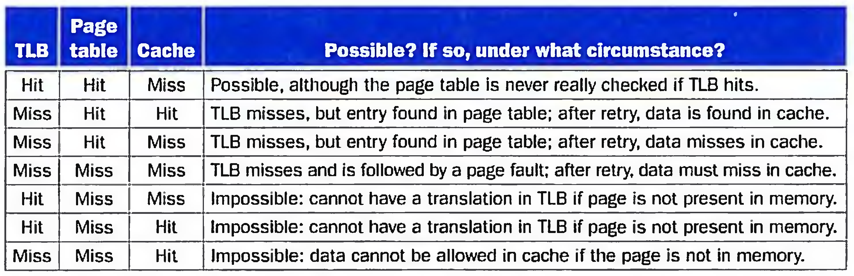
all combinations and whether each is possible in practice.

Slide 74
Memory Protection
Different tasks can share parts of their virtual address spaces
But need to protect against errant access
Requires OS assistance
Hardware support for OS protection
Privileged supervisor mode (aka kernel mode)
Privileged instructions
Page tables and other state information only accessible in supervisor mode
System call exception (e.g., ecall in RISC-V)

Slide 75
Implementing Protection with Virtual Memory
To enable the operating system to implement protection in the virtual memory system, the hardware must provide at least the three basic capabilities summarized below.
user process or an operating system
a portion of the processor state
processor can go from user mode to supervisor mode and vice versa.

Slide 76
RISC-V System Instructions
Type | Mnemonic | Name
Mem ordering | fence.i | Instruction fence
 | fence | Fence
 | sfence.vm | Address translation fence
CSR access | csrrwi | CSR read/write immediate
 | csrrsi | CSR read/set immediate
 | csrrci | CSR read/clear immediate
 | csrrw | CSR read/write
 | csrrs | CSR read/set
 | csrrc | CSR read/clear
System | ecall | Environment call
 | ebreak | Environment breakpoint
 | sret | Supervisor exception return
 | wfi | Wait for interrupt

Slide 77
context switch or process switch
A changing of the internal state of the processor to allow a different process to use the processor that includes saving the state needed to return to the currently executing process.

Slide 78
Handling TLB Misses and Page Faults
A TLB miss can indicate one of two possibilities:
1. The page is present in memory, and we need only create the missing TLB entry.
2. The page is not present in memory, and we need to transfer control to the operating system to deal with a page fault.
When we process the TLB miss, we will look for a page table entry to bring into the TLB. If the matching page table entry has a valid bit that is turned off, then the corresponding page is not in memory ,and we have a page fault, rather than just a TLB miss.
If the valid bit is on, we can simply retrieve the desired entry.

Slide 79
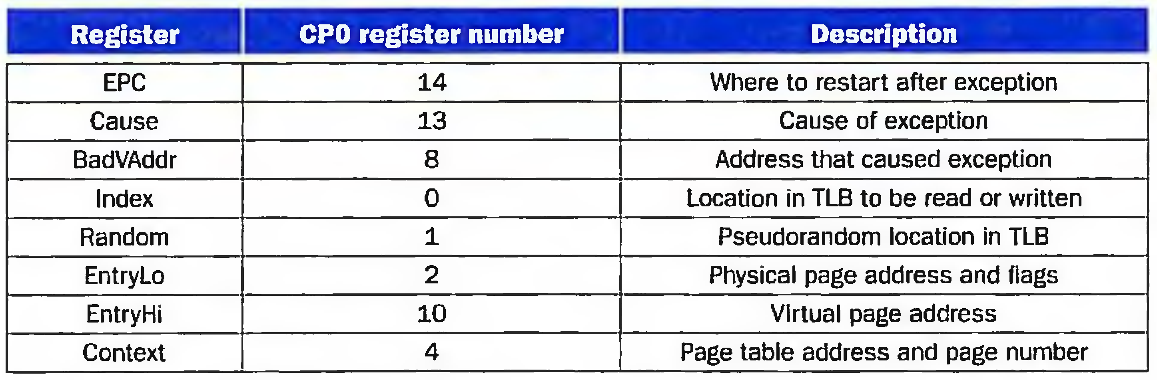
Control registers for TLB miss
A TLB miss can be handled by  software or hardware
MIPS control registers.
exception enable, interrupt enable.
A signal or action that controls whether the process responds to an exception or not; necessary for preventing the occurrence of exceptions during intervals before the processor has safely saved the state needed to restart.

Slide 80
What to do when page fault ?
Once the operating system knows the virtual address that caused the page fault, it must complete three steps:
1. Look up the page table entry using the virtual address and find the location of the referenced page on disk.
2. Choose a physical page to replace; if the chosen page is dirty, it must be written out to disk before we can bring a new virtual page into this physical page.
3. Start a read to bring the referenced page from disk into the chosen physical page.

Slide 81
Page fault exceptions for data accesses are difficult to implement properly in a processor because of a combination of three characteristics:
1. They occur in the middle of instructions, unlike instruction page faults.
2. The instruction cannot be completed before handling the exception.
3. After handling the exception, the instruction must be restarted as if nothing had occurred.
restartable instruction
An instruction that can resume execution after an exception is resolved without the exception's affecting the result of the instruction.
handler
Name of a software routine invoked to "handle" an exception or interrupt.
unsnapped
A portion of the address space that cannot have page faults.

Slide 82
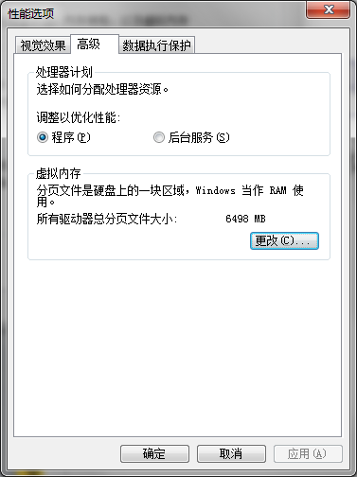
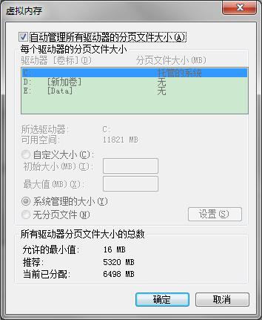
虚拟内存配置
设置虚拟存储
则系统有可能会频繁读取这部分页面文件，从而加大系统盘所在磁道的负荷
不设置
当系统出现蓝屏死机(特别是STOP错误)的时候，无法创建转储文件 (Memory.dmp)，从而无法进行 程序调试和错误报告了
折中
在系统盘（速度最快的C盘）设置较小的页面文件，只要够用就行了。

Slide 83
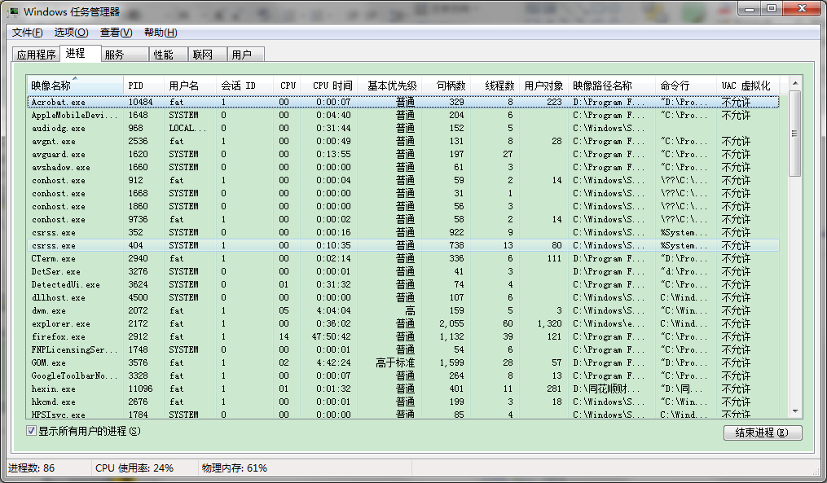
任务管理器（处理器相关）

Slide 84
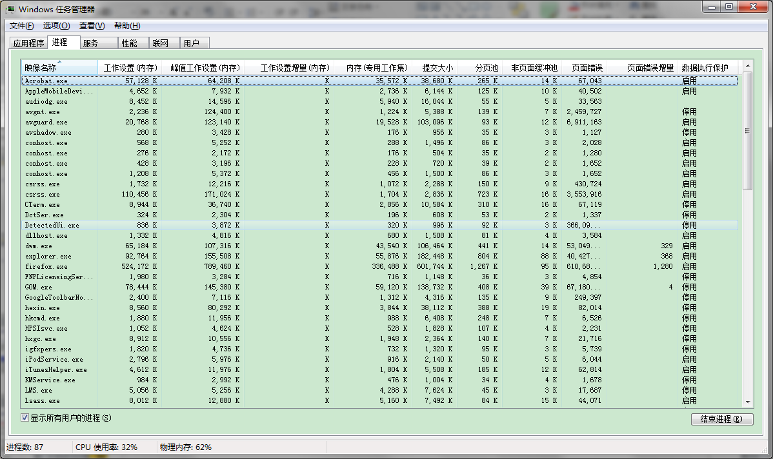
任务管理器（内存、虚拟内存）

Slide 85
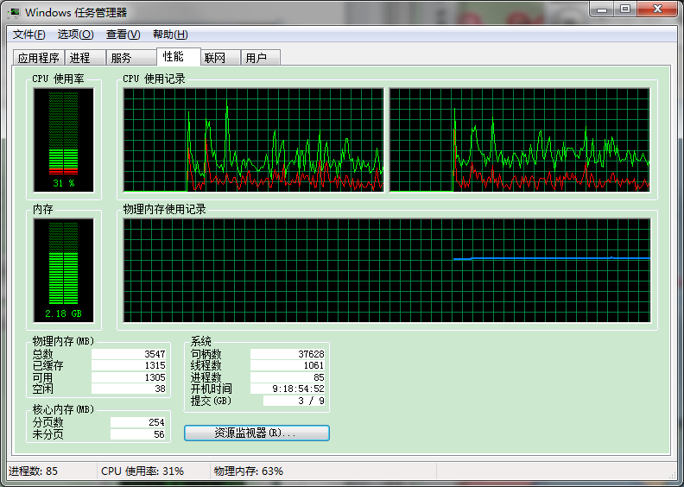
任务管理器（性能，包括CPU、内存）

Slide 86
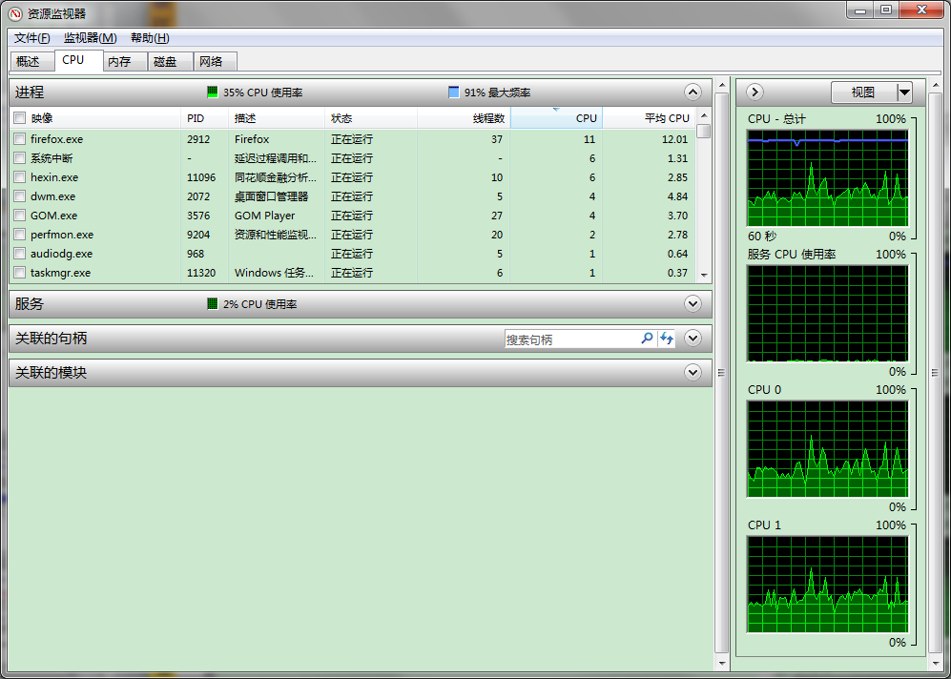
资源监视器（CPU）

Slide 87
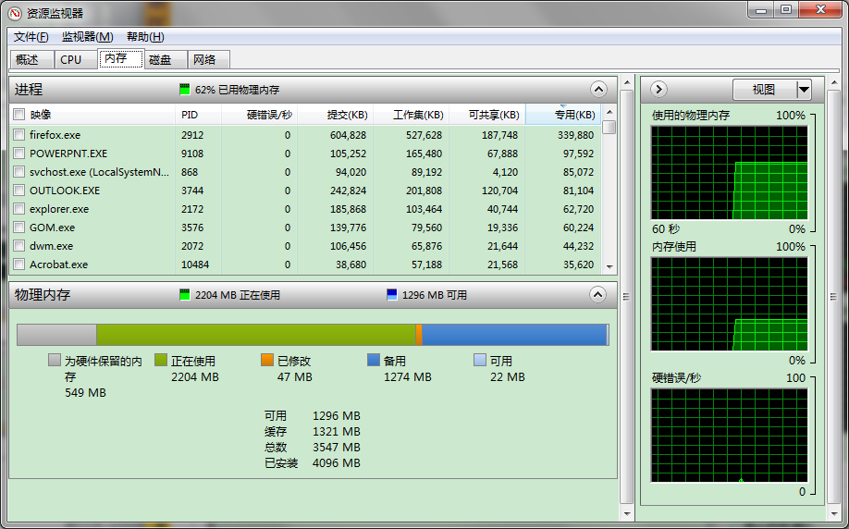
资源监视器（内存）

Slide 88
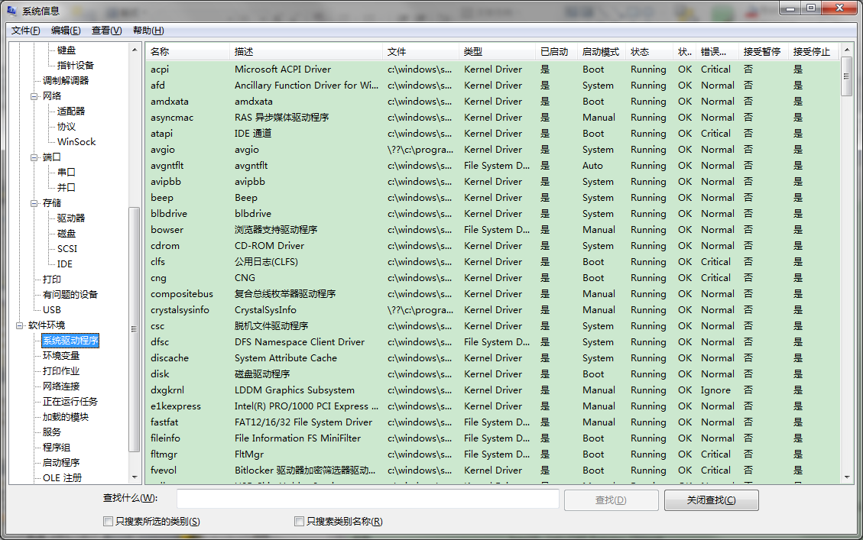
系统信息（软件环境）

Slide 89
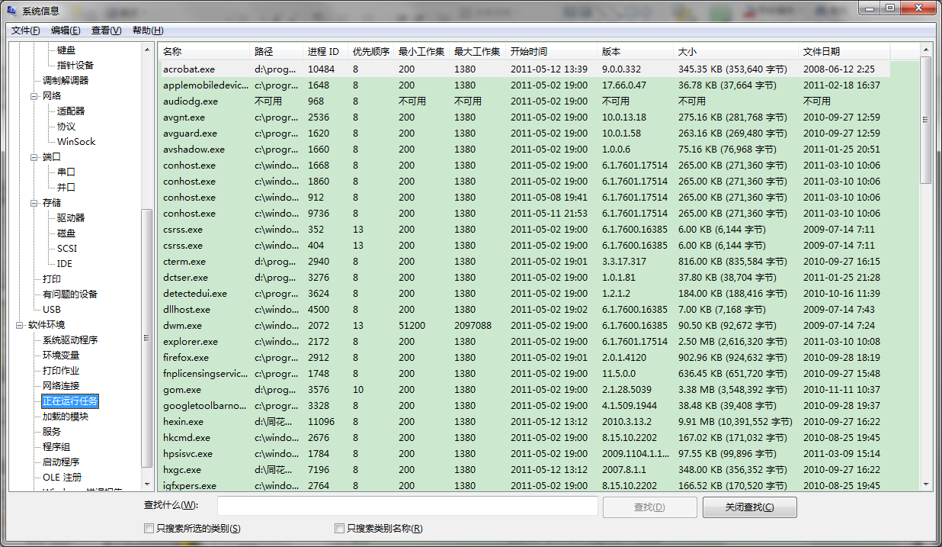
系统信息（正在运行任务占内存）

Slide 90
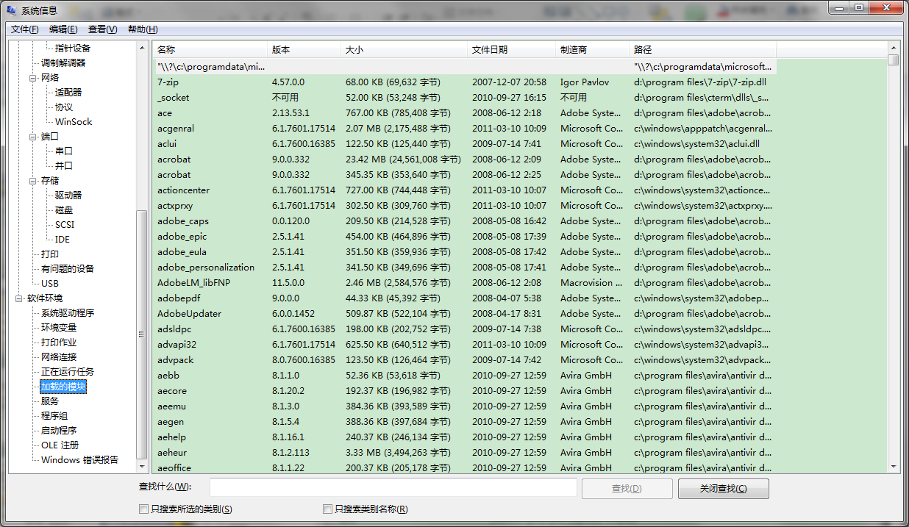
系统信息（加载的模块占内存）

Slide 91
5.6 Virtual Machines
Host computer emulates guest operating system and machine resources
Improved isolation of multiple guests
Avoids security and reliability problems
Aids sharing of resources
Virtualization has some performance impact
Feasible with modern high-performance comptuers
Examples
IBM VM/370 (1970s technology!)
VMWare
Microsoft Virtual PC

Slide 92
Virtual Machine Monitor
Maps virtual resources to physical resources
Memory, I/O devices, CPUs
Guest code runs on native machine in user mode
Traps to VMM on privileged instructions and access to protected resources
Guest OS may be different from host OS
VMM handles real I/O devices
Emulates generic virtual I/O devices for guest

Slide 93
Example: Timer Virtualization
In native machine, on timer interrupt
OS suspends current process, handles interrupt, selects and resumes next process
With Virtual Machine Monitor
VMM suspends current VM, handles interrupt, selects and resumes next VM
If a VM requires timer interrupts
VMM emulates a virtual timer
Emulates interrupt for VM when physical timer interrupt occurs

Slide 94
Instruction Set Support
User and System modes
Privileged instructions only available in system mode
Trap to system if executed in user mode
All physical resources only accessible using privileged instructions
Including page tables, interrupt controls, I/O registers
Renaissance of virtualization support
Current ISAs (e.g., x86) adapting

Slide 95
5.8 Memory Hierarchy summary
Common principles apply at all levels of the memory hierarchy
Based on notions of caching
At each level in the hierarchy
Block placement
Finding a block
Replacement on a miss
Write policy

Slide 96
Block Placement
Determined by associativity
Direct mapped (1-way associative)
One choice for placement
n-way set associative
n choices within a set
Fully associative
Any location
Higher associativity reduces miss rate
Increases complexity, cost, and access time

Slide 97
Finding a Block
Associativity | Location method | Tag comparisons
Direct mapped | Index | 1
n-way set associative | Set index, then search entries within the set | n
Fully associative | Search all entries | #entries
 | Full lookup table | 0
Hardware caches
Reduce comparisons to reduce cost
Virtual memory
Full table lookup makes full associativity feasible
Benefit in reduced miss rate

Slide 98
Replacement
Choice of entry to replace on a miss
Least recently used (LRU)
Complex and costly hardware for high associativity
Random
Close to LRU, easier to implement
Virtual memory
LRU approximation with hardware support

Slide 99
Write Policy
Write-through
Update both upper and lower levels
Simplifies replacement, but may require write buffer
Write-back
Update upper level only
Update lower level when block is replaced
Need to keep more state
Virtual memory
Only write-back is feasible, given disk write latency

Slide 100
Sources of Misses
Compulsory misses (aka cold start misses)
First access to a block
Capacity misses
Due to finite cache size
A replaced block is later accessed again
Conflict misses (aka collision misses)
In a non-fully associative cache
Due to competition for entries in a set
Would not occur in a fully associative cache of the same total size

Slide 101
Cache Design Trade-offs
Design change | Effect on miss rate | Negative performance effect
Increase cache size | Decrease capacity misses | May increase access time
Increase associativity | Decrease conflict misses | May increase access time
Increase block size | Decrease compulsory misses | Increases miss penalty. For very large block size, may increase miss rate due to pollution.

Slide 102
5.9 Using FSM to Control a simple Cache
Example cache characteristics
Direct-mapped, write-back, write allocate
Block size: 4 words (16 bytes)
Cache size: 16 KB (1024 blocks)
32-bit byte addresses
Valid bit and dirty bit per block
Blocking cache
CPU waits until access is complete
31
14
13
4
3
0
Tag
Index
Offset
18 bits
10 bits
4 bits

Slide 103
Interface Signals
CPU
Cache
Memory
Read/Write
Read/Write
Valid
Valid
Address
32
Address
32
Write Data
32
Write Data
128
Read Data
32
Read Data
128
Ready
Ready
Multiple cycles per access, Ready is invalid until data is read/write back

Slide 104
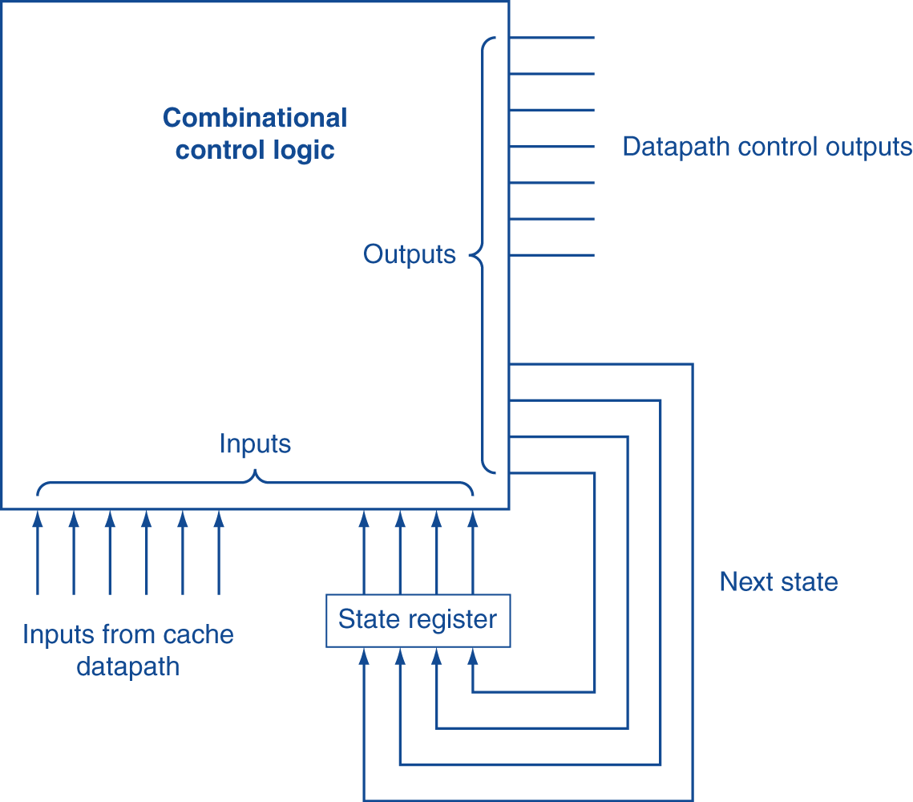
Finite State Machines
Use an FSM to sequence control steps
Set of states, transition on each clock edge
State values are binary encoded
Current state stored in a register
Next state = f_{n} (current state, current inputs)
Control output signals = f_{o} (current state)

Slide 105
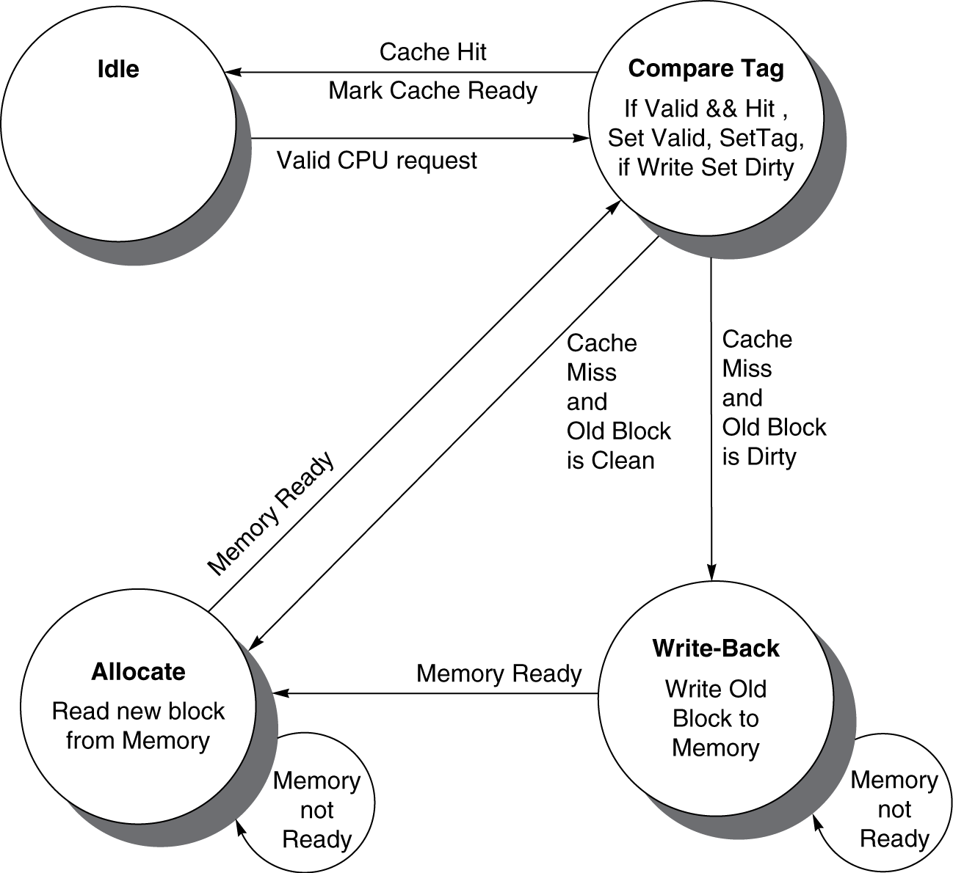
Cache Controller FSM
Could partition into separate states to reduce clock cycle time

Slide 106
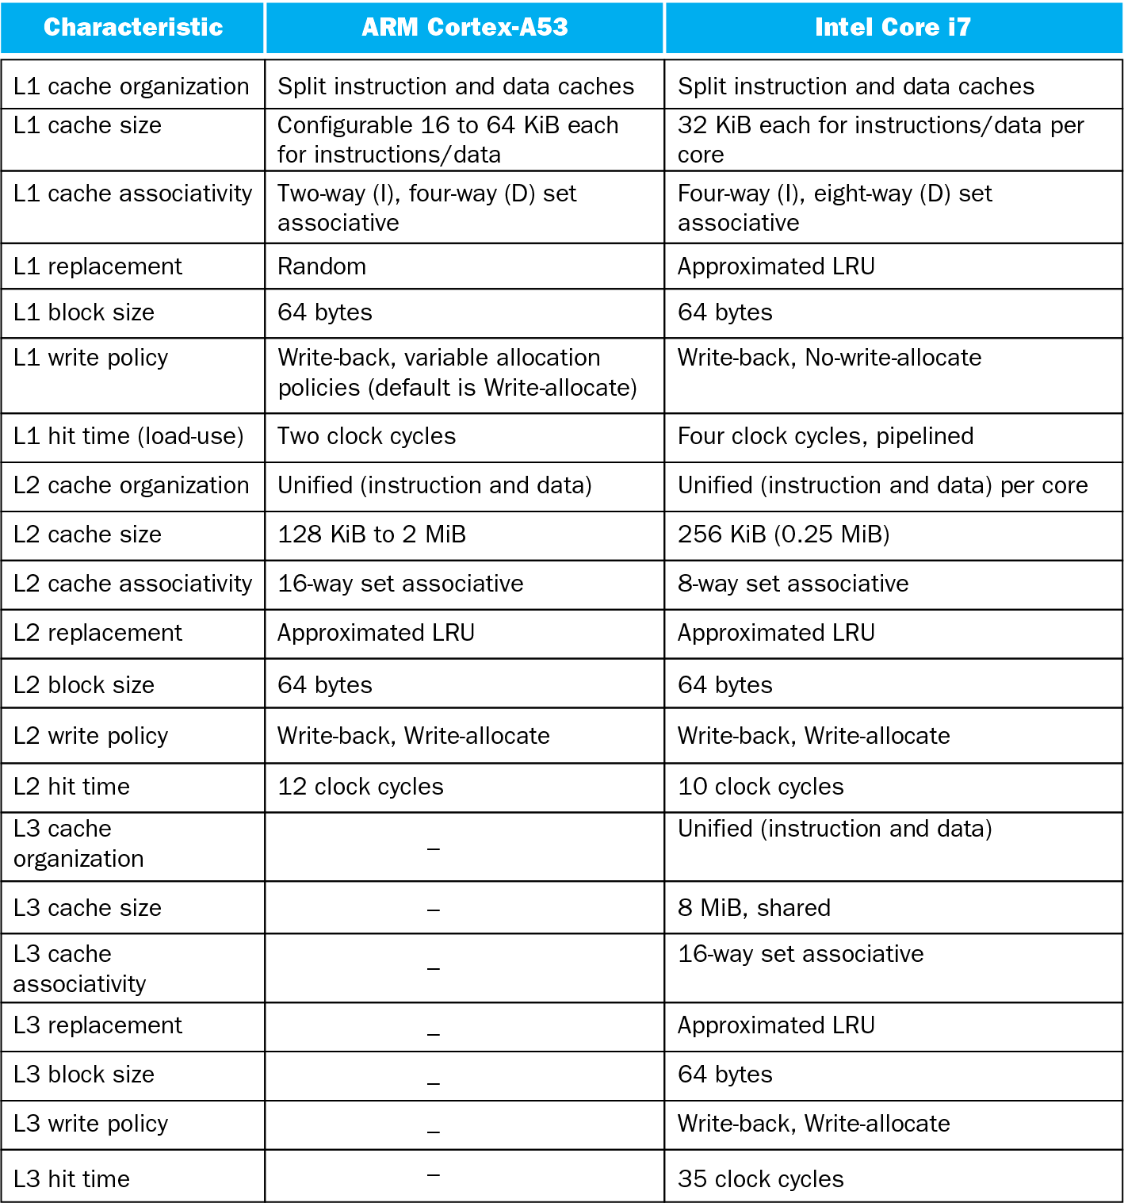
Modern Systems-Cache

Slide 107
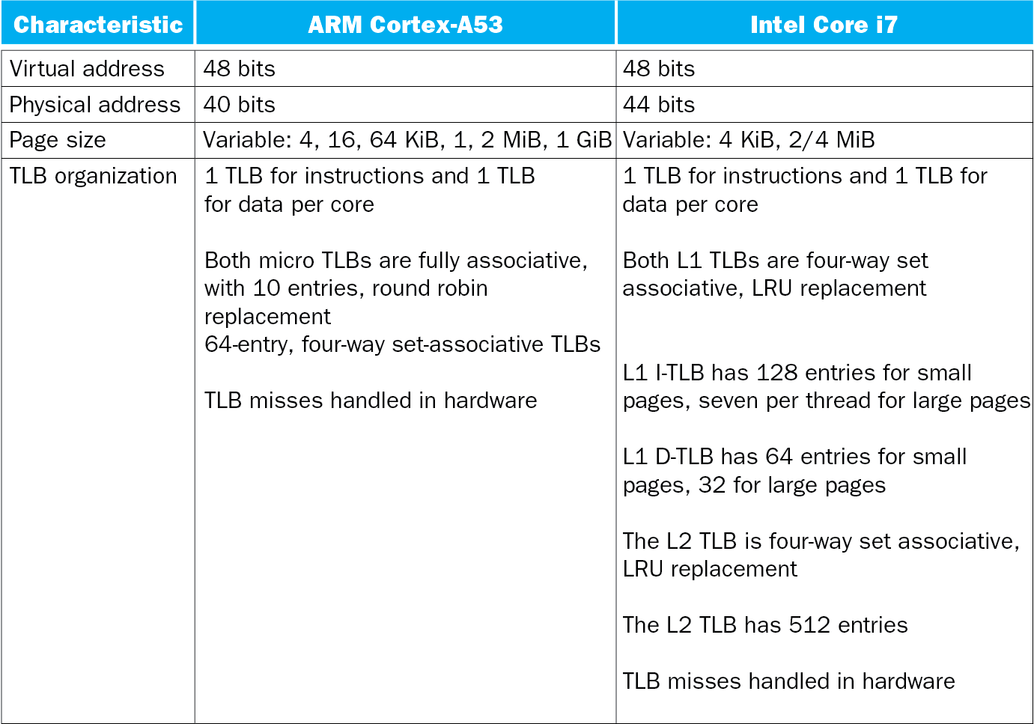
Modern Systems-TLB

Slide 108
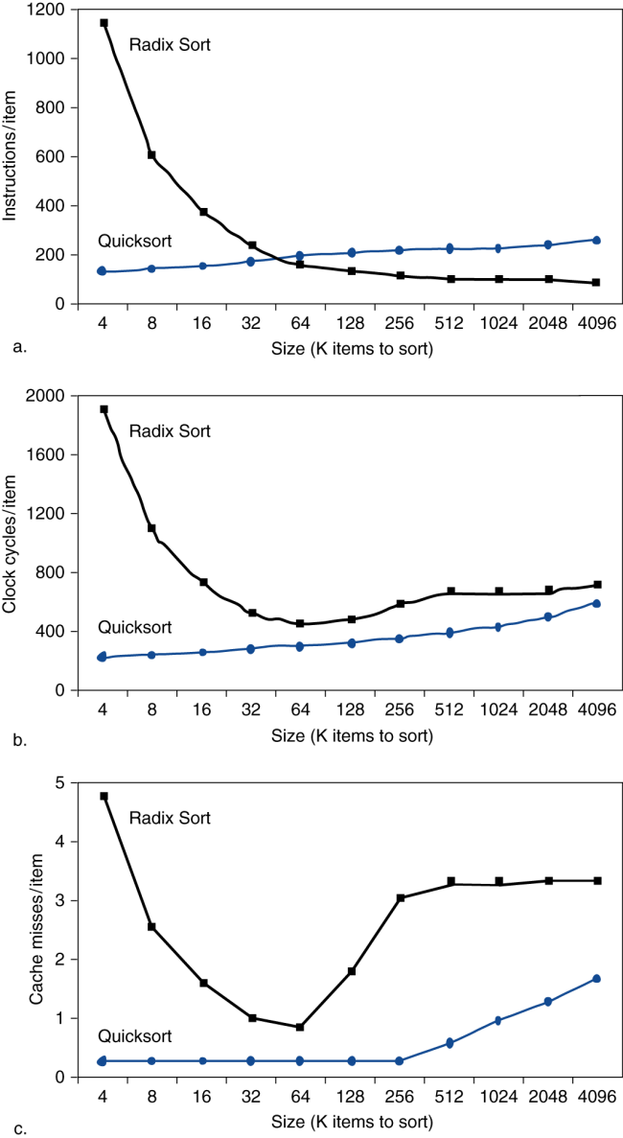
Interactions with Software
Misses depend on memory access patterns
Algorithm behavior
Compiler optimization for memory access

Slide 109
编译优化：提高空间局部性
导致i与j内存地址对32Word取mod为一样。
main() {
int i, array[31], j;
for (i=0;i<100;i++)
for(j=0;j<100;j++)
…
}
解决方案: 换为int i, j, array[31];

Slide 110
编译优化：提高时间局部性
访问内存序列为 array[0][0], array[1][0], array[0][1], array[1][1]…
main() {
int i, j, array[32][32];
for (i=0;i<31;i++)
for(j=0;j<31;j++)
array[i][j] = array[i+1][j] + 1;
}
解决方案：先for j, 然后for i
更多优化见编译技术课程
访问内存序列为 array[0][0], array[1][0], array[1][0], array[2][0]，array[2][0], array[3][0]…
main() {
int i, j, array[32][32];
for (j=0;j<31;i++)
for(i=0;i<31;j++)
array[i][j] = array[i+1][j] + 1;
}
解决方案：先for j, 然后for i

Slide 111
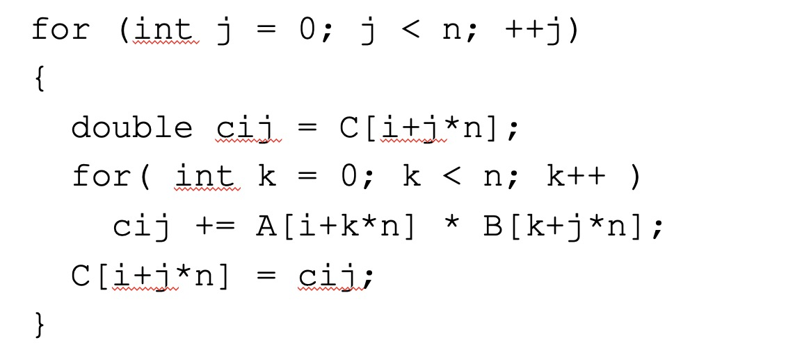
Software Optimization via Blocking
Goal: maximize accesses to data before it is replaced
Consider inner loops of DGEMM:

Slide 112
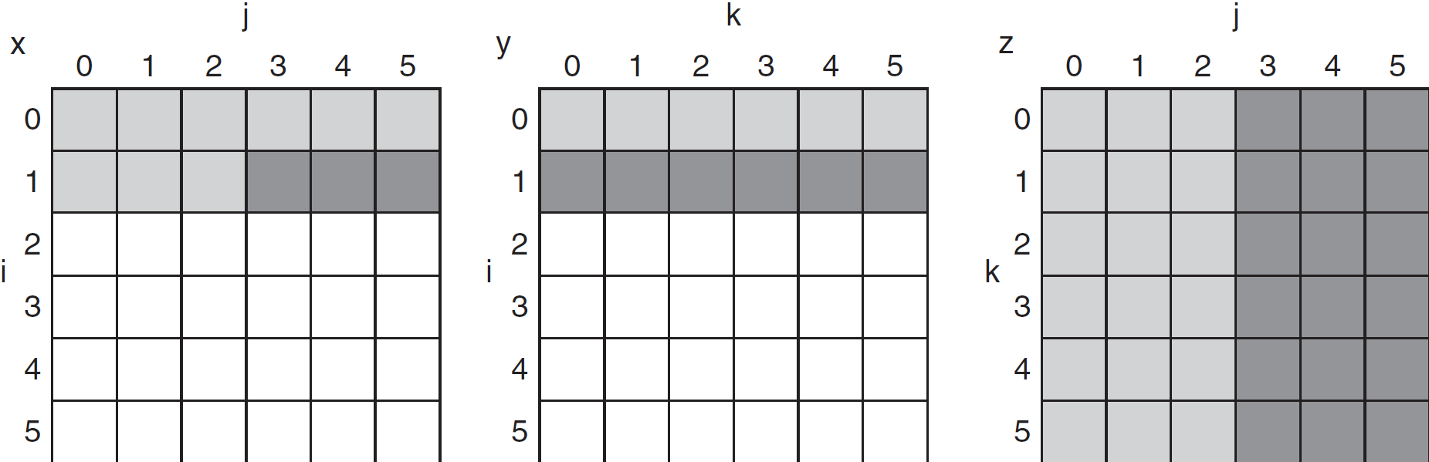
DGEMM Access Pattern
C, A, and B arrays
older accesses
new accesses

Slide 113
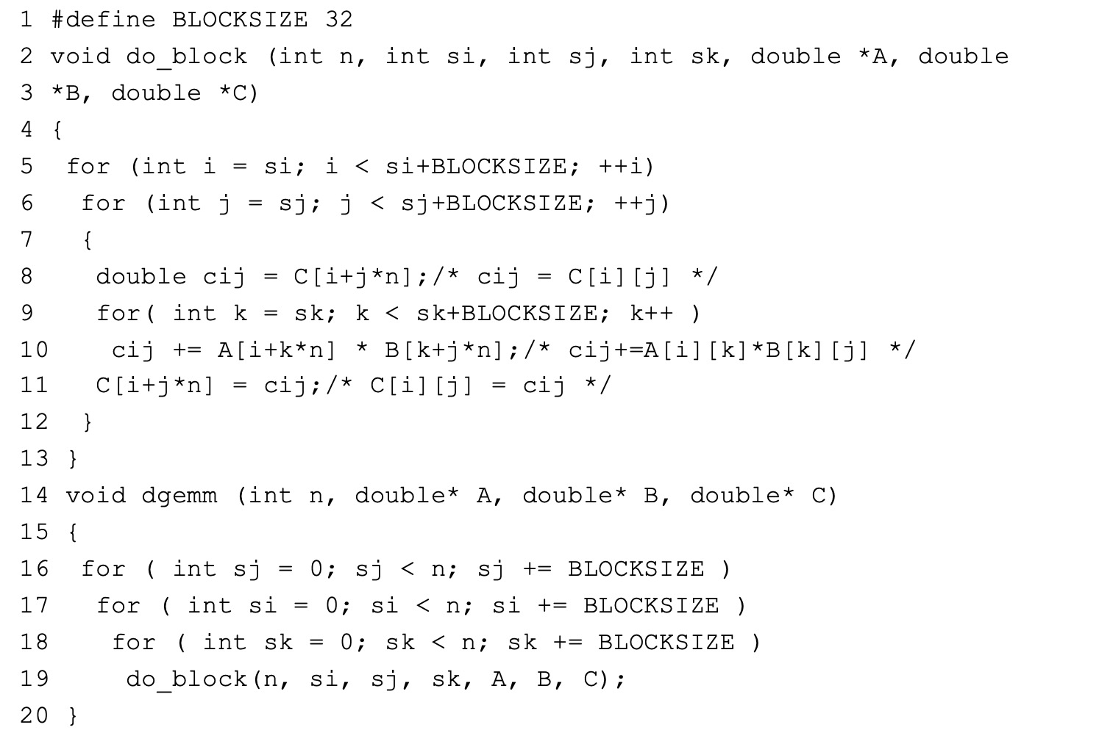
Cache Blocked DGEMM

Slide 114
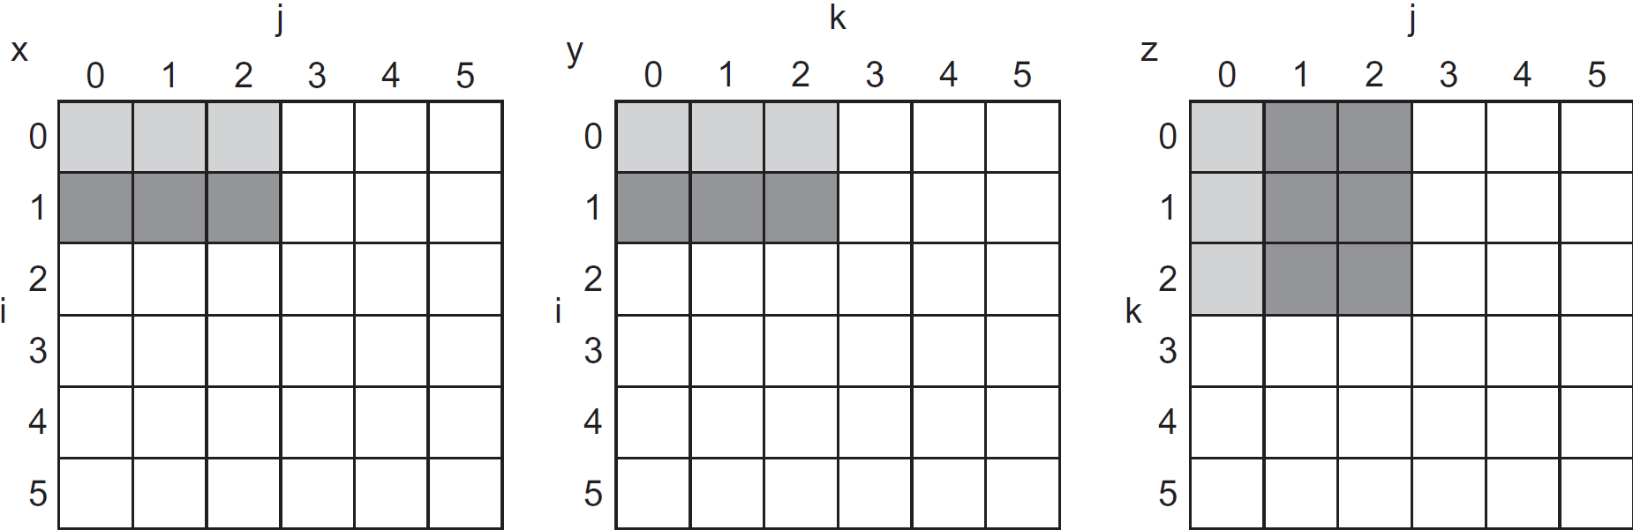
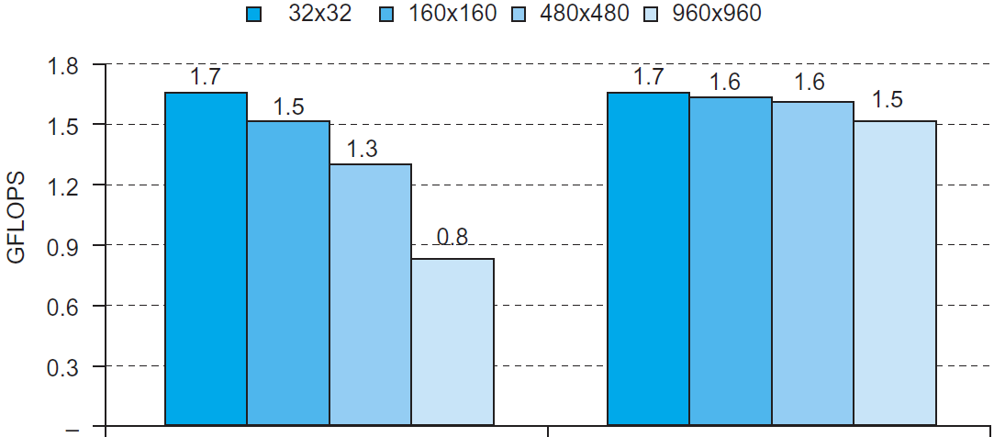
Blocked DGEMM Access Pattern
Unoptimized
Blocked

Slide 115
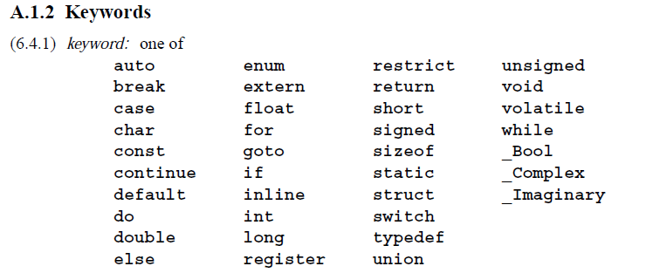
C语言keyword
以下摘自C标准ISO9899:1999，ANSI于2000年3月采用
绿色为C90新增（删除了旧版的关键字entry）），红色为C99新增
增加5个保留字restrict 、_Bool（布尔）、_Complex（复数）、inline 、_Imaginary（虚数）

Slide 116
restrict
只能用于指针，表明该指针是数据对象的唯一且初始的方式（不是通过指针的赋值运算另外来得的），便于编译器进行代码优化。
主要用做函数变元，或者指向由malloc()函数所分配的内存变量。
restrict数据类型不改变程序的语义。
如果某个函数定义了两个restrict指针变元，编译程序就假定它们指向两个不同的对象
memcpy()函数就是restrict指针的一个典型应用示例。
C89中memcpy()函数原型如下：
代码: void *memcpy (void *s1， const void *s2， size_t size)；
如果s1和s2所指向的对象重叠，其操作就是未定义的。
memcpy()函数只能用于不重叠的对象。
C99中memcpy()函数原型如下：
代码: void *memcpy(void *restrict s1， const void *restrict s2，size_t size)； 通过使用restrict修饰s1和s2 变元，可确保它们在该原型中指向不同的对象。

Slide 117
程序调优与课程对应
单核程序调优
语言级：选择哪种语言与运行环境→C/C++/ MFC/计组/汇编
变量级：变量类型、near/far指针、字符串、数组→ C语言/计组
函数级：内联、define→ C语言/计组/操作系统
库级：静态库、动态库、动态编译→计组/编译
数据结构级：哪种数据结构最快最省内存→计组/数据结构/编译
存储优化：cache命中率、内存池→计组/体系
算法级：哪种算法最快，最省内存→数据结构/算法理论
IO级：文件/网络操作、人机交互、IO缓存等→操作系统/接口
处理器级：汇编指令优化、利用处理器特点→汇编/计组/体系
多核程序调优→多核程序/流计算
分布程序调优→网格计算/云计算

Slide 118
流程
性能评测方法
baseline、性能问题、性能原因、验证
性能评测工具Profiler
vtune/ Oprofile/KFT/Gprof/Performance counter
cache优化
了解用了什么cache
Cache层次（L1/L2/L3）、cache大小、cache line大小、关联度、cache类型（IC/DC/mini）
IC优化
精简code path，简化调用关系，减少冗余代码…
DC优化
部分内容摘自KernelChina文章

Slide 119
Code adjacency （把相关代码放在一起）；
Cache line alignment （cache对齐）；
Branch prediction （分支预测）；
Data prefetch (数据预取）；
Memory coloring （内存着色）；
Register parameters （寄存器参数）；
Lazy computation （延迟计算）；
Early computation （提前计算）；
Macro or not macro (宏定义或者宏函数）；
Allocation on stack （局部变量）；
Multiple conditions （多个条件的判断语句）；
Per-cpu data structure (非共享的数据结构）；
64 bits counter in 32 bits environment （32位环境里的64位counter）；
Reduce call path or call trace （减少函数调用的层次）；
Move exception path out （把exception处理放到另一个函数里面）；
Read, write split （读写分离）；
Reduce duplicated code（减少冗余代码）；
Use compiler optimization options （使用编译器的优化选项）；
Know your code path （了解所有的执行路径，并优化关键路径）

Slide 120
处理器优化
处理器专用汇编指令，如SSE、AVX
处理器器件利用率，如超线程、多发射
加速硬件，如GPU、音视频编解码器
分布式计算：如hadoop，GFS
批量操作：批处理
减少用户空间/内核空间的切换和数据交换
缓存：输入缓存、输出缓存、中间数据缓存
时间/空间/能耗的tradeoff
调频：turbo boost 2.0可以提高频率，ACPI/DVS可以调低频率
池技术：内存池、线程池
内存优化：内存交换、垃圾回收GC、GUI内存
函数调用优化：回调、输入输出数据集
并行性挖掘：
并发性挖掘：
锁机制：锁的类型、消息、共享内存、如何消除锁
事务内存
原子操作
编译器优化：用处理器厂家的编译器，选用合适的选项
混合编程
函数式编程FP

Slide 121
END

